Slide 1
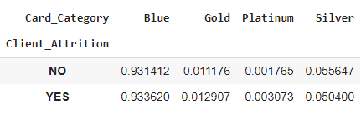
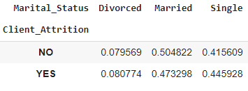
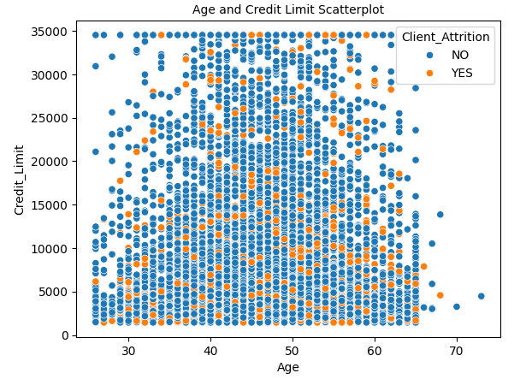
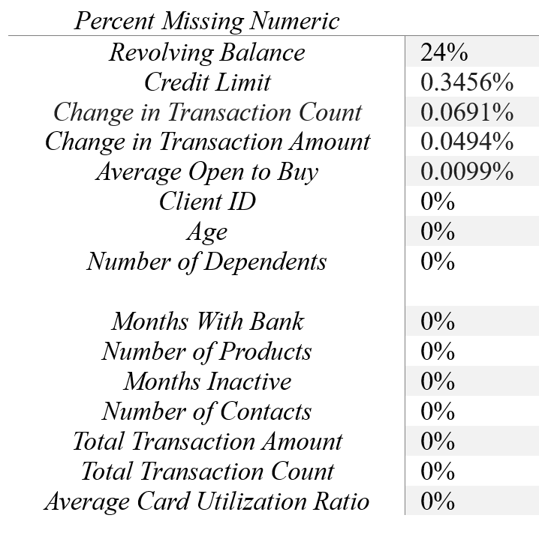
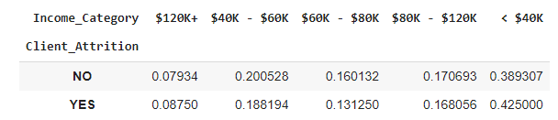
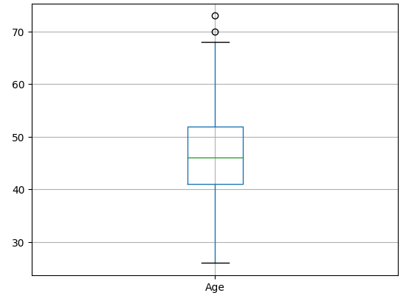
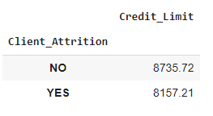
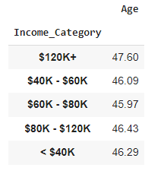
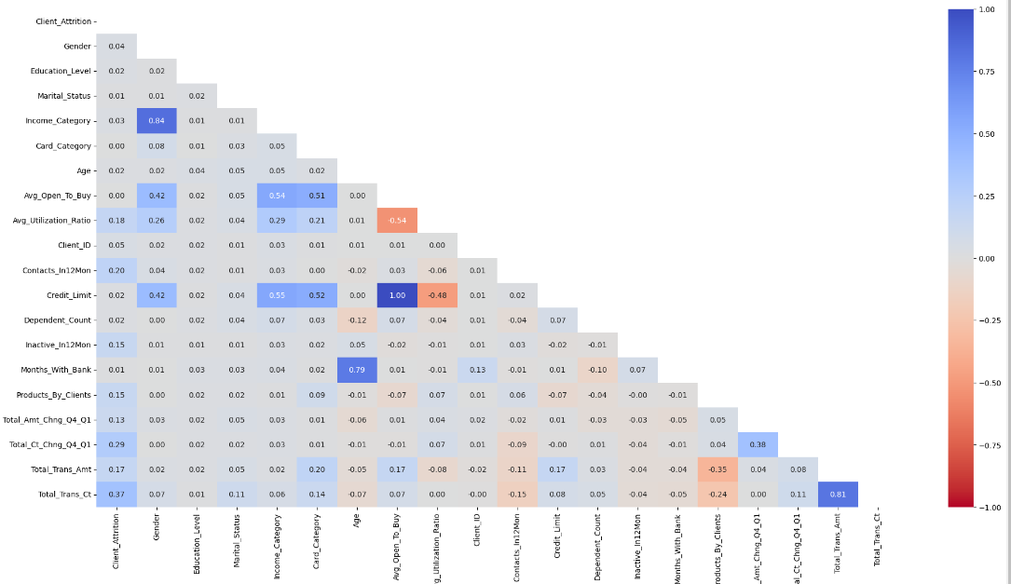
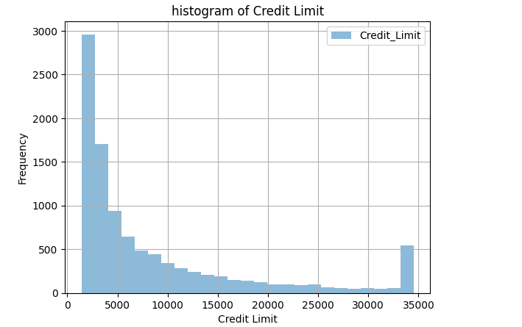
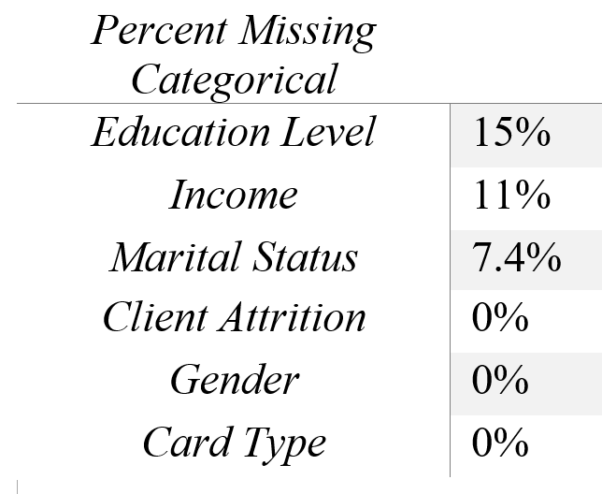
Notes:
Part 1:
There are 10,127 rows and 21 columns
The charts on the left show the percentage missing per variable.
We removed the “Revolving Balance” variable as over 15% of its contents were missing.
Part 2:
We did univariate analysis on the Client Attrition, Card Category, Marital Status, and Income Category variables.
Boxplot of Age and Histogram of Credit Limit
Part 3:
Client Attrition by Credit Limit; Age and Income Category
Scatter Plot
Heat Map

